Slide 1
Verilog-A implementation of hourglass model
Stefan Cosemans (verilog-A implementation and example netlists)
Robin Degraeve (model equations)
Version : 2012-04-10
Notes:
<number>

Slide 2
Outline
Model description
See Robin Degraeve’s PTW presentation October 2012
Verilog-A implementation
Examples
Notes
Stefan Cosemans
<number>
Notes:
<number>

Slide 3
Circuit simulation model
Verilog-A implementation of hourglass model
Latest update: March 9th
Features
I-V curves
Transient set and reset behavior
Includes stochastic jumping of particles
Does not include stochastic variations on ωx and ωy during operation
Temperature parameter is available as in hourglass model model
Self-heating is fundamental part of equations
Not automatically linked to spice’s environment temperature
No corners provided, as no data is available
Not that difficult to implement in spice IF parameter distribution is available
Beware
Not carefully compared with Robin’s implementation
No resources available to support the model
Compatibility
Works well in spectre (spice simulator of Cadence)
Tested in hspice. Works, but performance is significantly worse
<number>
Stefan Cosemans

Slide 4
Outline
Model description
Verilog-A implementation
Introduction
Including a RRAM cell in a simulation
Model parameters
Stored signals
Examples
Notes
Stefan Cosemans
<number>
Notes:
<number>

Slide 5
Introduction
Instances of verilog-A models can be included in a netlist in the same way as transistors or resistors
Supported by all major spice simulators
Hspice
Spectre (Cadence’s spice simulator)
We perform our simulations with spectre
the examples do run with hspice 2010, but slower
Stefan Cosemans
<number>

Slide 6
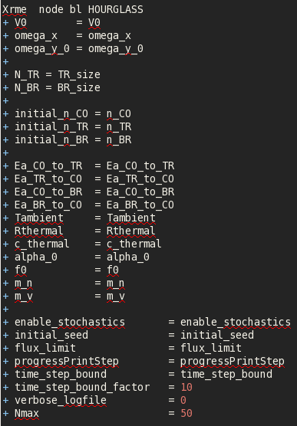
Including RRAM cell in netlist
Include verilog-A file
Instantiate the element like you would instantiate any other subcircuit in a netlist
Stefan Cosemans
<number>

Slide 7
Model parameters
Model contains
The hourglass model parameters
See Robin’s slides (February/March 2013)
Some simulation performance and debugging settings
Hourglass model parameters
Performance and debugging settings
Flux limitation needed because of extremely high number of jumps in reset condition → very slow simulation otherwise.
Current limitation approach is definitely not optimal...
Stefan Cosemans
<number>

Slide 8
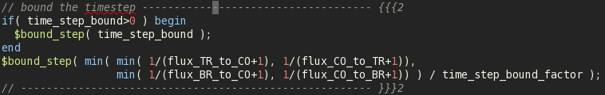
Performance and debugging settings
enable_stochastics:
0 [disable] or 1 [enable]
initial_seed:
integer, used as seed for random number generator
flux_limit:
Parameter to reduce simulation time.
In the verilog-A model, the probability of particles jumping between top reservoir (TR), constriction (CO) and bottom reservoir (BR) is expressed by the “fluxes”, the average number of particle jumps per second. This corresponds to 1/τ
4 fluxes: TR→CO, CO→TR, CO→BR, BR→CO
All fluxes in the model are limited to flux_limit value. If one flux exceeds this limit, all fluxes are divided by the same factor (only for that time point)
Otherwise, number of jumps in reset (dynamic balance) can be prohibitively large. “flux_limit” should be large enough to avoid clipping during the actual write transients.
ProgressPrintStep: print simulation progress on console
Time_step_bound: limit simulation timestep to maximal this value
Time_step_bound_factor: limit simulator timestep based on current time constants, divided by this factor
Verbose_logfile: 0 or 1
Nmax: number of terms that is evaluated in the formula for the QPC current calculation
Might be better to also include (counter-threshold) in the timestep bound in a clever way
Stefan Cosemans
<number>

Slide 9
Waves Stored in output database
State parameters stored in simulation waveforms:
Xrme.n_CO : number of particles in constriction
Xrme.n_TR : number of particles in top reservoir
Xrme.n_BR : number of particles in bottom reservoir
Xrme.temperature
Derived parameters
Xrme.log10_omega_y → omega_y=10x
Xrme.log10_flux_TR_to_CO_plus1000 → value = 10x-1000
Also: CO_to_TR, BR_to_CO, CO_to_BR
These values are before applying the flux reduction factor.
Xrme.log10_counter_TR_to_CO_plus1000 → value = 10x-1000
The counters increase according to the fluxes. When a counter reaches its threshold, a particle jumps and a new threshold is selected.
Xrme.log10_jumps_TR_to_CO_plus1000 → value = 10x-1000
Tracks the total number of jumps that have occurred during the entire simulation
Xrme.log10_flux_reduction_factor_plus1000 → value = 10x-1000
All fluxes are divided by this value before being used to increase counters
Stochastic thresholds
Xrme.log10_threshold_TR_to_CO_plus1000 → value = 10x-1000
After each particle jump, a new threshold is selected from an exponential distribution.
Some signals are stored as x=log(v) or x=log(v+1000).
Otherwise, large value variations result in convergence issues..
Stefan Cosemans
<number>

Slide 10
Debug information
Always check the information that is generated in ./logs/all_RMEs.log
There will be counter overflows, which means that the simulator used a timestep which was too large, resulting in a delayed particle jump
This reduces the write speed in the circuit simulation compared to the actual model equations
This will often happen in the reset regime, when the cell is already reset. At that point, it is probably ok to ignore it
If it happens during the onset of the set, it might have significant impact
Stefan Cosemans
<number>

Slide 11
Outline
Model description
Verilog-A implementation
Examples
Install signalStorageToolbox
1R + 1RME saw tooth set-reset-set-reset sweep
1T + 1RME cell read-set-read-reset-…
Stefan Cosemans
<number>
Notes:
<number>

Slide 12
Install signalStorageToolbox
Needed if you want to use the matlab script to plot the simulation results of the examples
This is optional, but I would highly recommend it...
You can get the (free, BSD licensed) signalStorageToolbox
http://homes.esat.kuleuven.be/~scoseman/toolboxes/SignalStorageToolbox/index.html
It comes with some examples and documentation
Stefan Cosemans
<number>

Slide 13
Notice: the images in the next slides are from previous versions of the model
Outline
Model description
Verilog-A implementation
Examples
Install signalStorageToolbox
1R + 1RME saw tooth set-reset-set-reset sweep
1T + 1RME cell read-set-read-reset-…
Stefan Cosemans
<number>
Notes:
<number>

Slide 14
1R 1RME example
Rload
VRME
RME
+-
Vexternal
Stefan Cosemans
<number>

Slide 15
1R + 1RME (spectre)
Generate the netlists
Start matlab in the root directory of the package
This is where the file “java.opts” is located
Go to ./netlists/hourglass_examples/setreset_sweep/
Run writeNetlists.m
This generates the netlists in the subdirectory “generated”
Note: pre-generated netlists are provided in the distribution in case matlab is not available
Run the simulations [command line]
Source your simulator scripts. [mmsim for spectre]
Go to “generated” folder
Execute ./performAllSimulations.sh
Plot the waveforms
In matlab, execute “plotAllSimulationResultsSpectre.m”
Change the cell/simulation settings in “simulationSettings.m”
Rerun writeNetlists, performSimulations, plotAllSimulationResults
Notice: current default parameters are not aligned with latest model parameters used by Robin
Stefan Cosemans
<number>

Slide 16
Notice: not recently tested
1R + 1RME (hspice)
Alter the netlist
You will have to change the simulation statements in the netlist. You can do this either in the netlist template (setreset_sweep.m2s) or in the generated netlists (sp files). Comment the spectre statements and uncomment the hspice statements (POST, not CSDF).
Generate the netlists
Start matlab in the root directory of the package
This is where the file “java.opts” is located
Go to ./netlists/hourglass_examples/setreset_sweep/
Run writeNetlists.m
This generates the netlists in the subdirectory “generated”
Note: pre-generated netlists are provided in the distribution in case matlab is not available
Run the simulations [command line]
Source your simulator scripts.
Go to “generated” folder
Perform the spice simulation(s)
Visualize the results
Open the simulation results with your favorite waveviewer (eg cscope)
Or use plotAllSimulationResultsSpectre.m in matlab
Stefan Cosemans
<number>

Slide 17
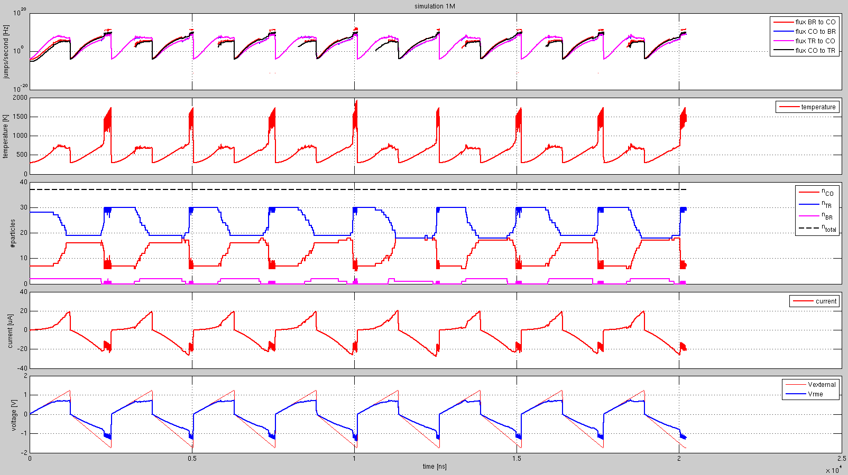
1MV/second --- versus time
Stefan Cosemans
<number>

Slide 18
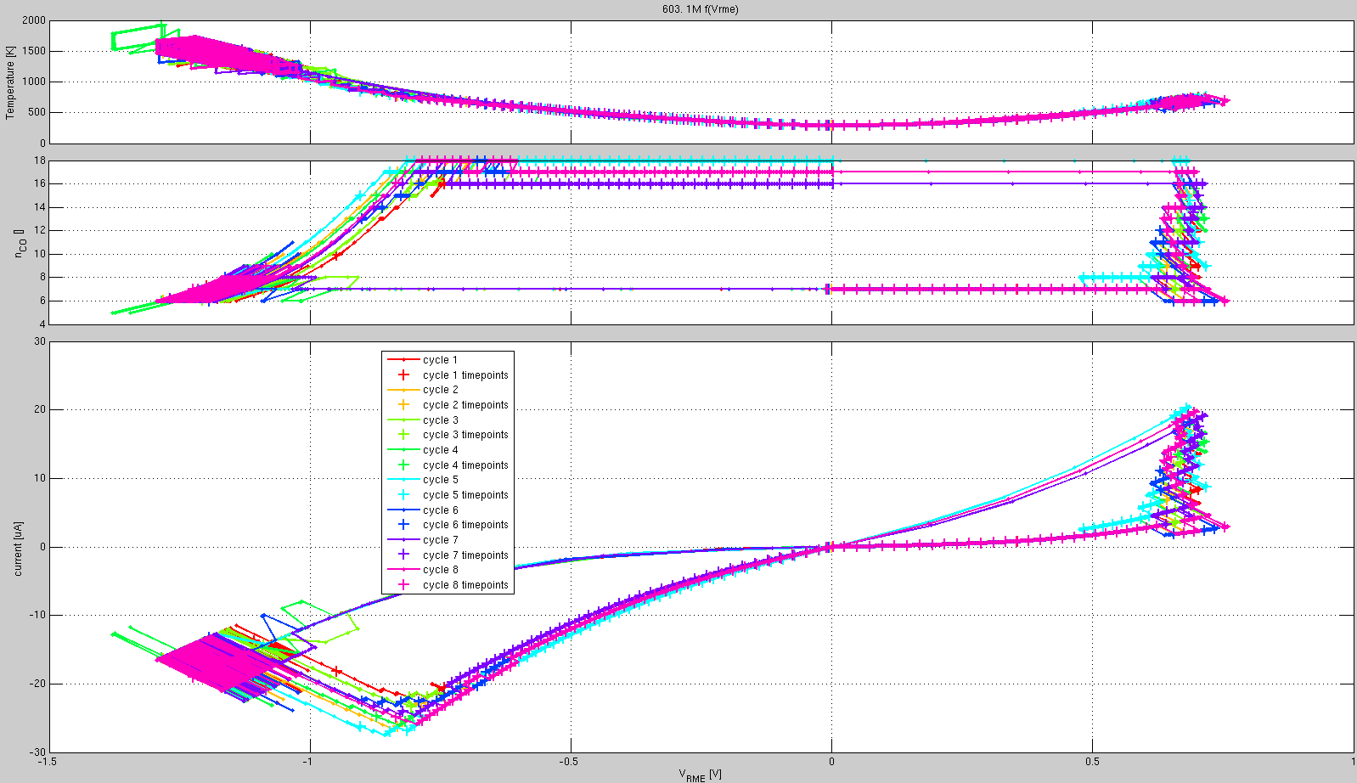
1 MV/second – versus VRME
Stefan Cosemans
<number>

Slide 19
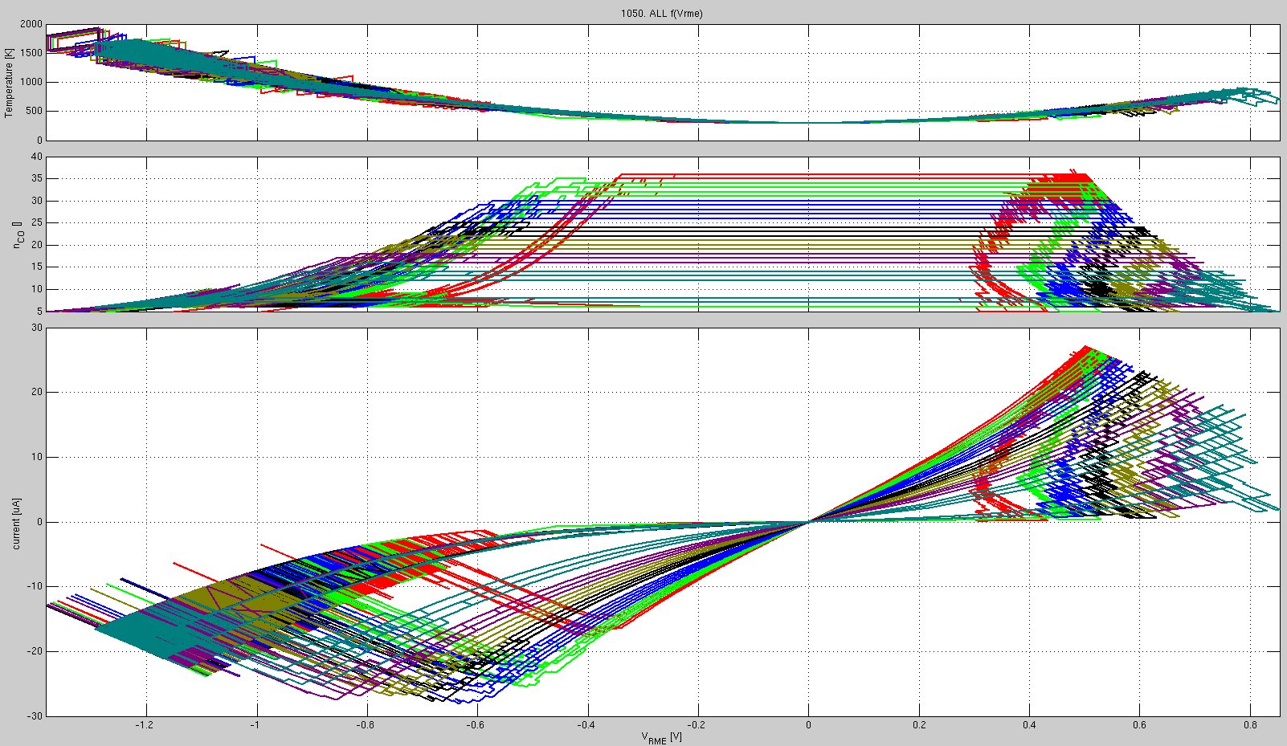
Different ramp rates
1V/s, 100V/s, 1KV/s, 10KV/s, 100KV/s, 1MV/sec, 10MV/s
Stefan Cosemans
<number>

Slide 20
Notice: the images in the next slides are from previous versions of the model
Outline
Model description
Verilog-A implementation
Examples
Install signalStorageToolbox
1R + 1RME saw tooth set-reset-set-reset sweep
1T + 1RME cell read-set-read-reset-…
Stefan Cosemans
<number>
Notes:
<number>

Slide 21
Running the example
Same as the 1R 1RME example
But in directory ./netlists/hourglass_examples/transistor/
Stefan Cosemans
<number>

Slide 22
1T 1RME example
WL
SL
BL
RME
vdd
vdd
-0.2V
set
RME
vdd
0
vdd
reset
RME
Run same way as the other example, but in ./netlists/hourglass_examples/transistor/
Stefan Cosemans
<number>

Slide 23
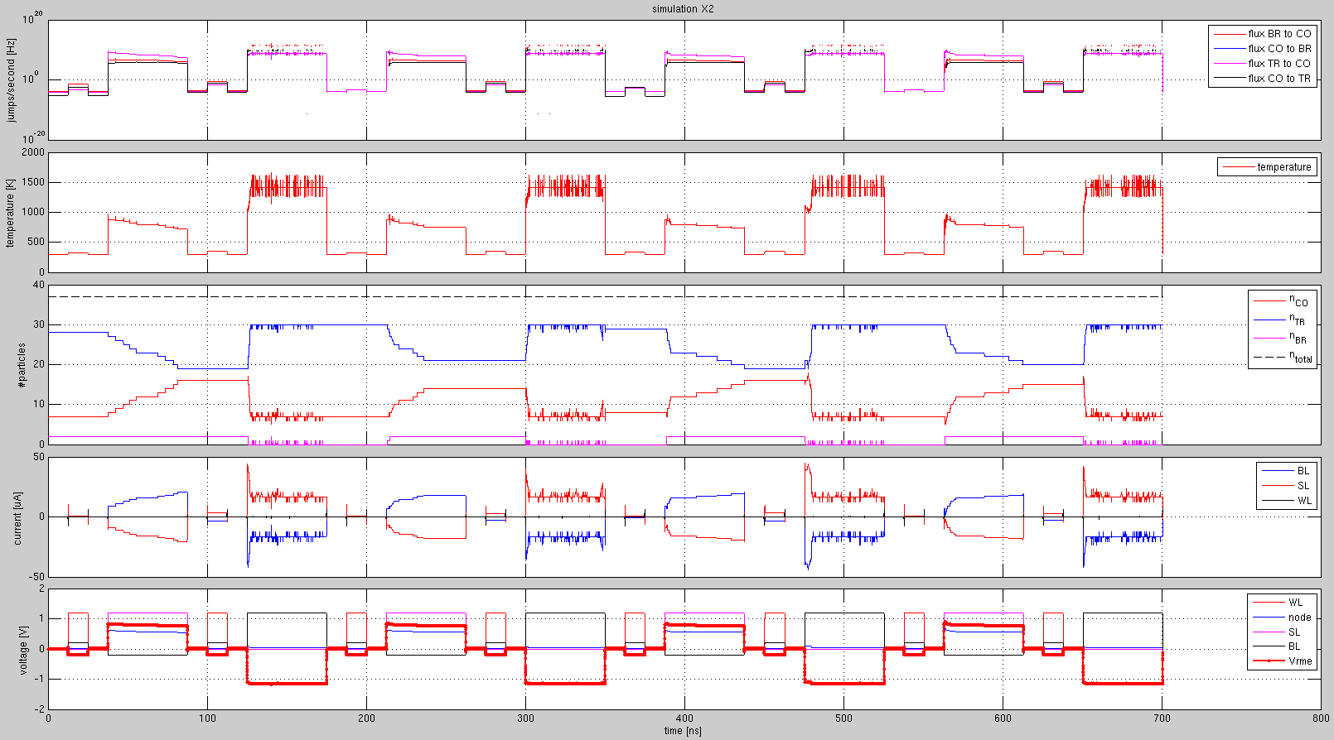
1T 1RME – time waveforms
set
reset
set
reset
set
reset
set
reset
Stefan Cosemans
<number>

Slide 24
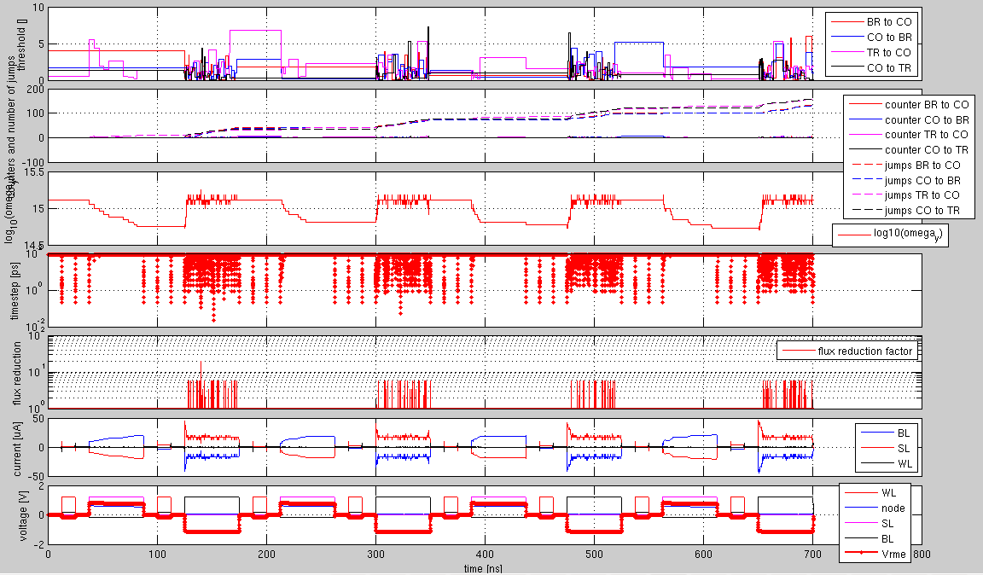
1T 1RME – time waveforms (2)
set
reset
set
reset
set
reset
set
reset
Stefan Cosemans
<number>

Slide 25
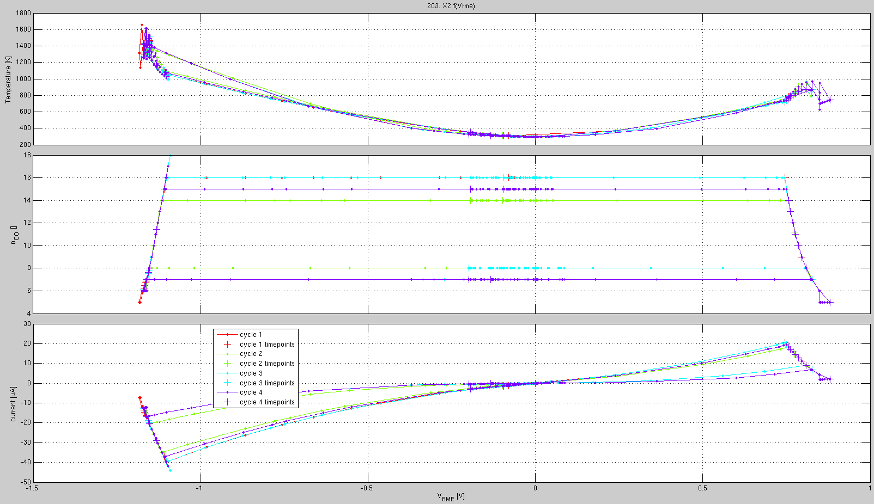
1T 1RME – versus VRME
Stefan Cosemans
<number>

